Slide 1
Infection Prevention and Control for 2019 Novel Coronavirus Infection. Interim guidance (3.2.2020)
Developed with input from MOH, WHO,CDC,IDI

Slide 2
Outline
2019 novel Coronavirus (2019-nCoV) Infection
What is 2019-nCoV?
How is it spread?
Who is at risk?
How does 2019-nCoV Infection present?
How do you protect yourself?
Infection prevention and control

Slide 3
2019 novel Coronavirus(2019-nCoV)
Coronaviruses: Family of enveloped RNA viruses, of zoonotic origin
Has resemblance to previously isolated suggesting zoonotic origin of virus
85% resemblance-Bat SARS-like-Cov and 79.5% to SARS-Cov
Cause a variety of illnesses
Common cold (229E, OC43, NL63, and HKU1)
Middle East Respiratory Syndrome (MERS-CoV). Middle East, 2012
Severe Acute Respiratory Syndrome (SARS-CoV). China 2002-2003
A novel coronavirus (2019-nCoV) is a new strain that has not been previously identified in humans.

Slide 4
Transmission
Incubation period: 2- 14 days( This is based on what has been seen previously as the incubation period of MERS viruses
Human-to-human transmission can occur through droplets or contact.
Human-to-human transmission may occur due to laxity in IPC practices esp standard precautions

Slide 5
Current case definition (CDC)
Clinical |  | Epidemiologic risk
Fever or signs/symptoms of lower respiratory illness (e.g.cough or shortness of breath) or Asymptomatic individuals | AND | Any person, including health care workers, who has had close contact- with a laboratory­ confirmed112019-nCoV patient within 14 days of symptom onset
Fever or signs/symptoms of lower respiratory illness (e.g. cough or shortness of breath) or Asymptomatic individuals | AND | A history of travel from Hubei Province, China
Fever and signs/symptoms of a lower respiratory illness (e.g., cough or shortness of breath) requiring hospitalization | AND | A history of travel from mainland China within 14 days of symptom onset

Slide 6
Signs and symptoms
Wide spectrum from asymptomatic carriage to severe life threatening syndromes such as ARDS. Complications include
Acute renal Injury
Acute cardiac Injury
Respiratory failure
Acute Respiratory distress syndrome (ARDS) -17-29% of hospitalised patients in China
Secondary infection/superinfection reported (including DR A baumanni, K puemoniae, and Candida Spp)
Up to 23% of patients need ICU interventions (data from a cohort of 99 patients)
Chen N et al.DOI:https://doi.org/10.1016/S0140-6736(20)30211-7

Slide 7
Goals of Infection Prevention and Control
Protect yourself
Protect your community
Protect your patients

Slide 8
Principles of infection prevention and control strategies associated with health care with suspected 2019-nCoV
Ensuring triage, early recognition, and source control (isolating patients with suspected 2019-nCoV
Application of Standard Precautions for all patients
Implementation of empiric additional precautions (droplet and contact and whenever applicable airborne precautions) for suspected cases. Consider Airborne precautions for aerosol-generating procedures
Administrative controls
Environmental and engineering controls

Slide 9
Ensuring triage, early recognition, and source control
Encourage HCWs to have a high level of clinical suspicion, and use updated case definitions
Establish a well-equipped triage station at the entrance of health facilities
Reinforce adherence to standard precautions especially respiratory hygiene and hand hygiene
Ensure that patients with symptoms of suspected 2019-nCoV or other respiratory infection (e.g., fever, cough) are not allowed to wait among other patients seeking care. Provide a face mask to symptomatic patients

Slide 10
2. Applying standard precautions for all patients
Hand hygiene
Respiratory hygiene
Appropriate personal protective equipment (PPE) according to risk assessment
Injection safety practices/Sharps safety
Safe waste management
Proper linens, environmental cleaning and sterilization of patient-care equipment.

Slide 11
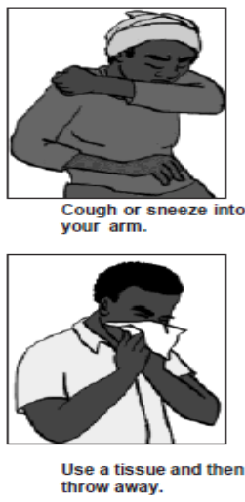
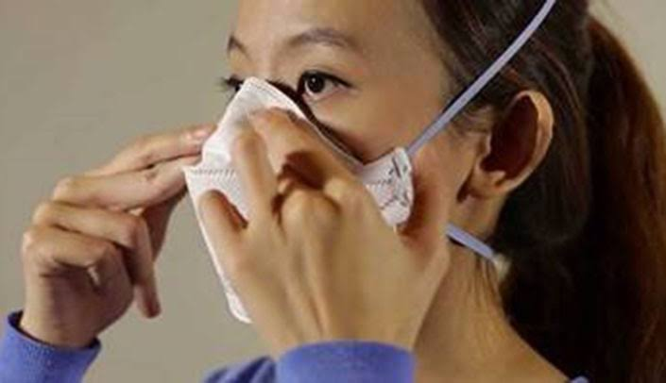
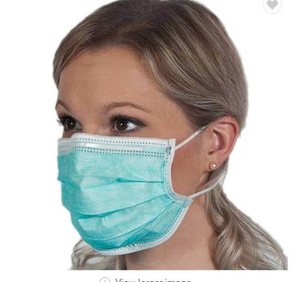
Respiratory or cough etiquette
Cover mouth and nose when coughing and sneezing
Maintain social distance (1.5metres) from others
Cover mouth and nose with tissue and dispose of the used tissues in the nearest waste bin
Health workers must put on fit tested N95 masks before entering the patient area or patient care
Offer a face mask to patients with suspected 2019-nCoV infection while they are in waiting/public areas or in isolation rooms.

Slide 12
Hand hygiene
Hand hygiene is the most important measure to prevent infection
Perform hand hygiene after contact with respiratory secretions.

Slide 13
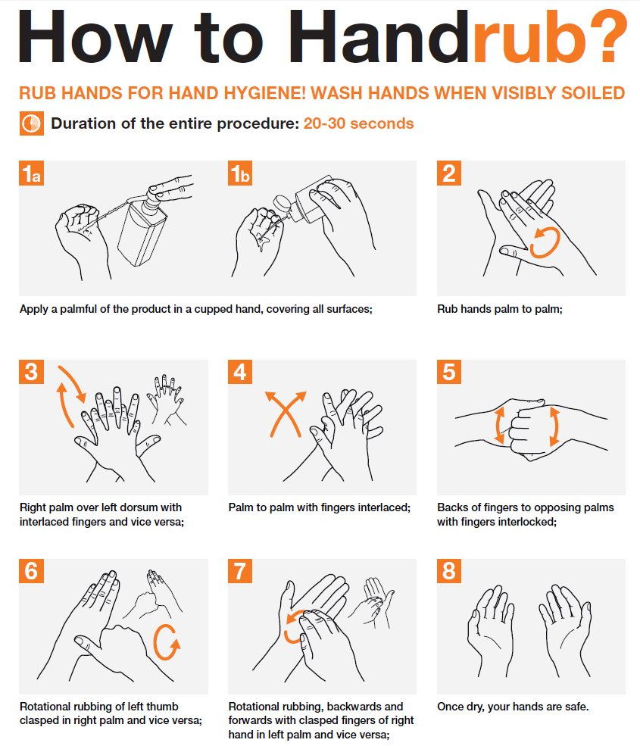

Slide 14
Personal protective equipment (PPE)
PPE recommendation for the general public:
For asymptomatic individuals, no PPE use is recommended. However proper hand hygiene practices and respiratory etiquette should suffice
For Health workers Supporting Triage or high risk gatherings
I addition to standard precautions, rapidly identify people with respiratory symptoms and put a face mask on them.
Screening teams should use fitted N95 respirators
Symptomatic staff are advised to stay home and inform relevant authorities
For Health workers caring for confirmed cases
In addition to standard precautions, health workers to use facial protection (Goggles), fitted respirators, gowns, gloves, and observe the 5 moments of hand hygiene

Slide 16
Risk assessment for appropriate use of PPE
Minimize direct unprotected exposure to blood and body fluids.
SCENARIO | HAND HYGIENE | GLOVES | GOWN | MEDICAL MASK | EYE- WEAR
Always before and after patient contact, and after contaminated environment | x
If direct contact with blood and body fluids, secretions, excretions, mucous membranes, non-intact skin | x | x
If there is risk of splashes onto the health care worker’s body | x | x | x
If there is a risk of splashes onto the body and face | x | x | x | x | x
HEALTH

Slide 17
Personal protective equipment (PPE)

Slide 18
3. Implementing empiric additional precautions
Patients should be placed in adequately ventilated single rooms.
when single rooms are not available, patients suspected of being infected with 2019-nCoV should be grouped together (Cohorting)
All patients’ beds should be placed at least 1 m apart regardless of whether they are suspected to have 2019-nCoV infection or not

Slide 19
Additional Contact and droplet precautions
Use designated equipment for patients under investigation/Confirmed patients
If transport is required, use predetermined transport routes to minimize exposure for staff, other patients and visitors, and have the patient using a medical mask;
Routinely clean and disinfect surfaces which the patient is in contact
Maintain a record of all persons entering the patient’s room, including all staff and visitors.

Slide 20
Isolation
Room doors should be kept closed except when entering or leaving the room, and entry and exit should be minimized. Patient movement out of the room should be minimized as well
Once a proper isolation room, the patient’s facemask may be removed.
Outside the isolation room, patients should wear a facemask to contain secretions and droplets
Personnel entering the room should use PPE, including respiratory protection, as described below.
In addition, the room should undergo appropriate cleaning and surface disinfection before it is returned to routine use.

Slide 21
4. Implementing administrative controls
Administrative controls and policies for the prevention and control of transmission of infections within the healthcare setting include
Establishing sustainable IPC infrastructures and activities;
Educating patients’ caregivers;
Developing policies on the early recognition of acute respiratory infection potentially caused by 2019-nCoV;
Ensuring access to prompt laboratory testing for identification of the etiologic agent;
Preventing overcrowding, especially in the emergency department;
Providing dedicated waiting areas for symptomatic patients;
Appropriately isolating hospitalized patients;
Ensuring adequate supplies of PPE;
Ensure the adherence of IPC policies and procedures for all facets of health care.

Slide 22
4.1. Administrative measures related to healthcare workers
Provision of adequate training for HCWs
Ensuring an adequate patient-to-staff ratio
Establishing a surveillance process for acute respiratory infections potentially caused by 2019-nCoV among HCWs
Monitoring HCW compliance with standard precautions and providing mechanisms for improvement as needed.

Slide 23
5. Using environmental and engineering controls
Spatial separation of at least 1 meter should be maintained between all patients.
Ensure that cleaning and disinfection procedures are followed consistently and correctly.
Cleaning environmental surfaces with water and detergent and applying commonly used hospital disinfectants (such as sodium hypochlorite) is an effective and sufficient procedure.
Manage laundry, food service utensils and medical waste in accordance with safe routine procedures.

Slide 24
Recommendation for outpatient care
Triage and early recognition
Emphasis on hand hygiene, respiratory hygiene and facemasks to be used by patients with respiratory symptoms
Prioritization of care of symptomatic patients
When symptomatic patients are required to wait, ensure they have a separate waiting area have a facemaks
Educate patients and families about the early recognition of symptoms, basic precautions to be used and which health care facility they should refer to.

Slide 25
Summary of recommendations
General Public | Screening and High risk Gatherings | Patient care setting
Observe proper hand hygiene using ABHR or soap and water Keep a 2m distance from patients with respiratory symptoms Try as much as possible to avoid hand contact with facial mucosa Proper respiratory manners No PPE required | Put face masks on a patients with respiratory symptoms Observe standard precautions Stay home when you are sick | Use of PPE including Disposable Gowns, goggles, respirators, gloves and hand hygiene Dedicate equipment for use on PUIs for nCov19 Monitor and manage all exposed and symptomatic HCWs

Slide 26
References
Infection prevention and control during health care when novel coronavirus (2019-nCoV) infection is suspected Interim guidance 25 January 2020. WHO
Interim Infection Prevention and Control Recommendations for Patients with Known or Patients Under Investigation for 2019 Novel Coronavirus (2019-nCoV) in a Healthcare Setting.CDC

